Slide 1
Attendance Management System
Optimi College

Slide 2
Stored Procedures
Display All
Fire Drill
Employee Display
Error Records Display
Fire Drill
In-and-Out View
Late today
Sign-In Display
Sign-Out Display
Sort Date Person

Slide 3
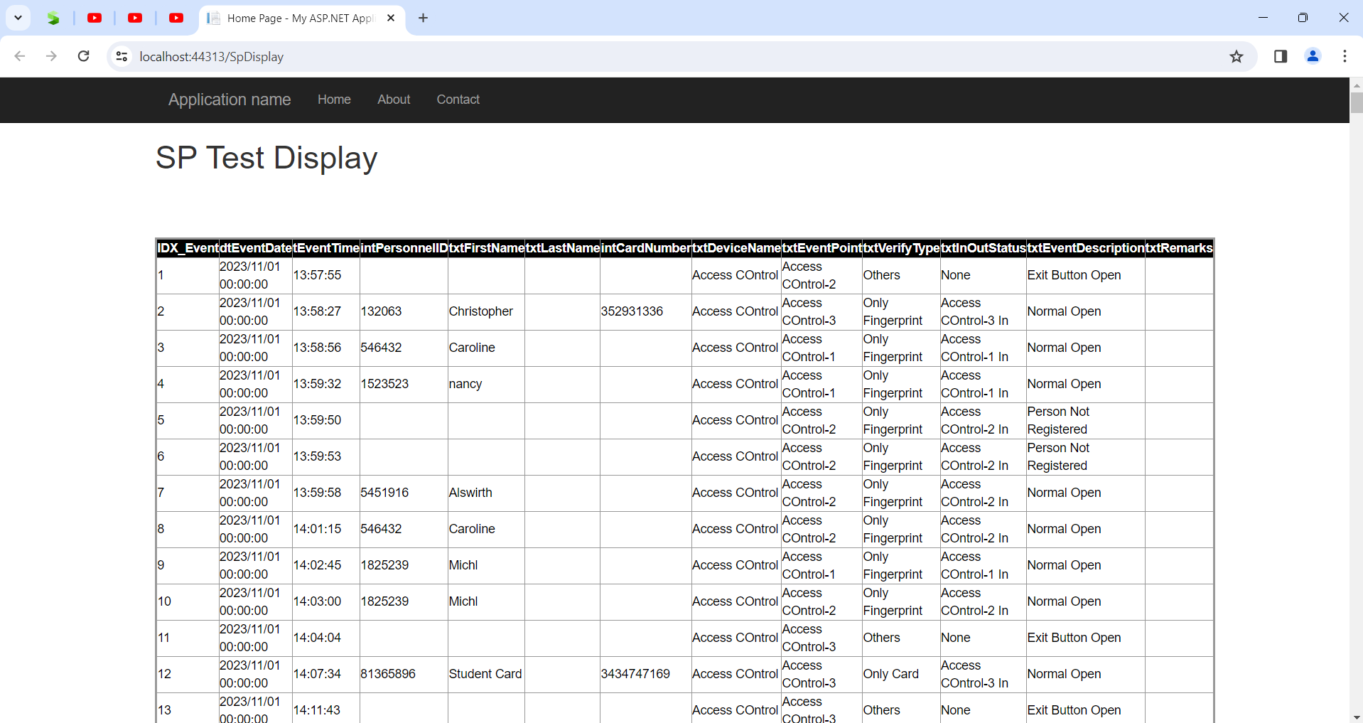
Display All

Slide 4
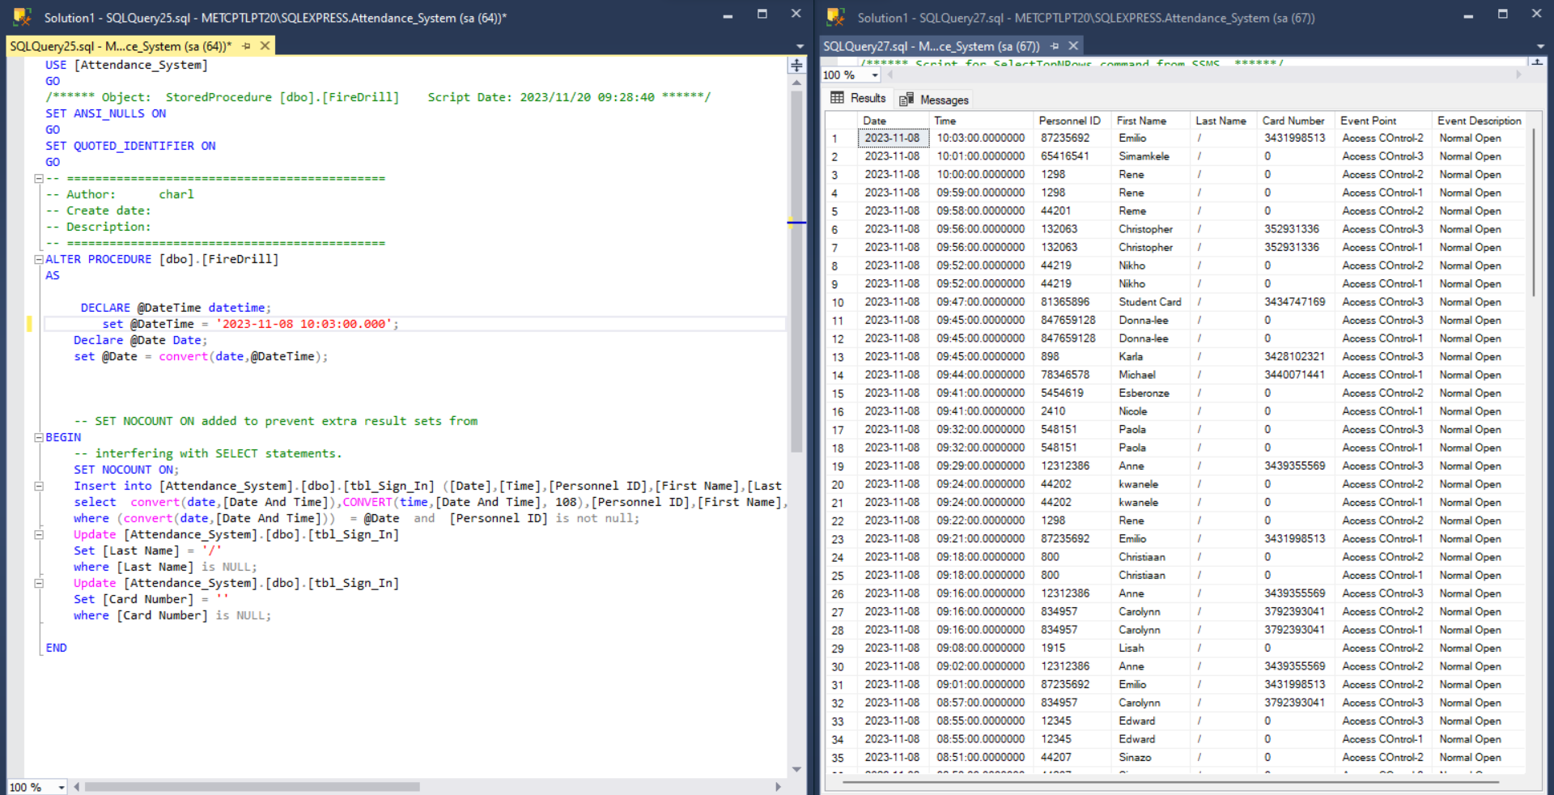
Fire Drill Stored Procedure

Slide 5
Thank you
The end

